Slide 1
Capstone Project
Live Class Monitoring System (Face Emotion Recognition)
Team
Rahul Kumar Soni, Lakdawala Ali Asgar

Slide 2
Content
Introduction
Problem Statement
Data Summary
Approach Overview
Model Overview
Model Evaluation
Real Time Face Emotion Detection
Deployment
Challenges
Conclusion

Slide 3
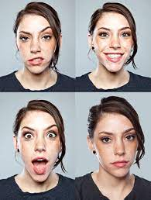
Introduction
Face Emotion Recognition
Importance
Applications
Product Development
Video game
Notes:
Facial Emotion recognition is a way of identifying the current emotional state of an individual to observers
Facial expressions can display personal emotions and indicate an individual's intentions within a social situation.
Facial expressions and other gestures convey nonverbal communication cues that play an important role in interpersonal relations. Eg A simple smile can indicate our approval of a message, while a scowl might signal displeasure or disagreement.These cues complement speech by helping the listener to interpret the intended meaning of spoken words. Therefore, facial expression recognition extracts and analyzes information from an image or video feed, it is able to deliver unfiltered, unbiased emotional responses as data.
Product Dev : Observing users interaction while interacting with a brand or a product helps the company to assess the effectiveness of any business product.
Video game testing phase. In this phase, usually a focus group of users is asked to play a game for a given amount of time and their behavior and emotions are monitored. By using facial expression recognition, game developers can gain insights and draw conclusions about the emotions experienced during game play and incorporate that feedback in the making of the final product.

Slide 4
Problem Statement
The Indian education landscape has been undergoing rapid changes for the past 10 years owing to the advancement of web-based learning services, specifically, eLearning platforms.
In a physical classroom during a lecturing teacher can see the faces and assess the emotion of the class and tune their lecture accordingly, whether he is going fast or slow. He can identify students who need special attention. Digital classrooms are conducted via a video telephony software program (ex- Zoom) where it’s not possible for medium-scale class (25-50) teacher to see all students and access the mood. Because of this drawback, students are not focusing on content due to a lack of surveillance. While digital platforms have limitations in terms of physical surveillance but it comes with the power of data and machines which can work for you. It data can be analyzed using deep learning algorithms which not only solves the surveillance issue, but it also removes the human bias from the system.

Slide 5
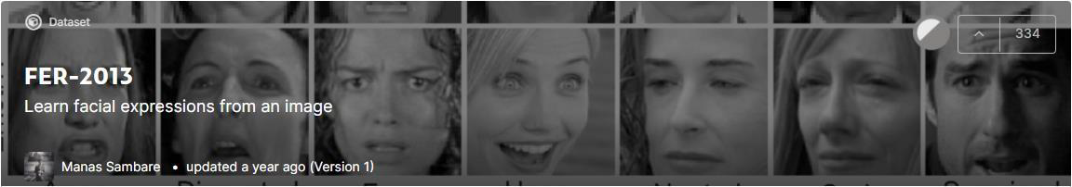
Data Summary
Data Set link
https://www.kaggle.com/msambare/fer2013
This dataset contains 35887 grayscale 48x48 pixel face images with seven emotions.
Notes:
The data was taken from a kaggle dataset known as FER 2013 short form for facial emotion recognition

Slide 6
Data Summary
Label | Emotion | No. of images for Training | No. of images for Testing
0 | Angry | 3995 | 958
1 | Disgust | 436 | 111
2 | Fear | 4097 | 1024
3 | Happy | 7215 | 1774
4 | Sad | 4830 | 1247
5 | Surprised | 3171 | 831
6 | Neutral | 4965 | 1233
Notes:
The data set is divided into 80 percent for training and 20 for validation.

Slide 7
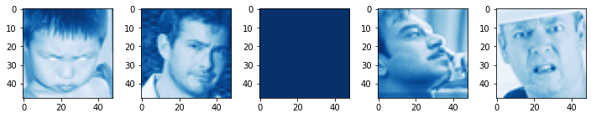
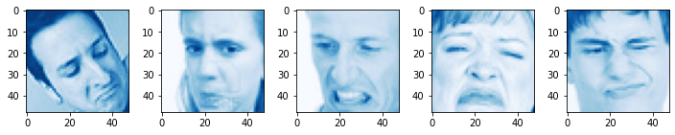
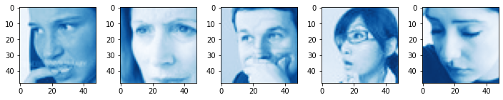
Data Summary
Angry
Disgust
Fear
Notes:
These are some 5 randomly generated images for each emotional expressions

Slide 8
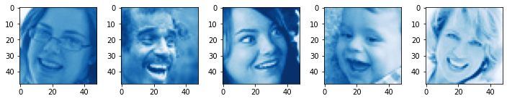
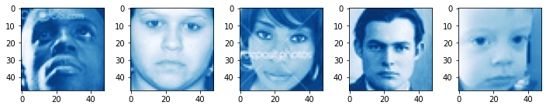
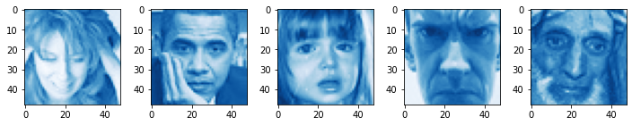
Data Summary
Happy
Sad
Surprised

Slide 9
Pipeline
Model evaluation & deployment
Data Exploration
Modeling
Understanding the data
Types of emotions
Images in each category
Modeling structures
Transfer learning
CNN
Graphs and applications
Loss & accuracy plots
Confusion matrix (Heatmap)
Streamlit
Heroku
Notes:
We build the app using streamlit and then deployed the application on heroku which is cloud platform

Slide 10
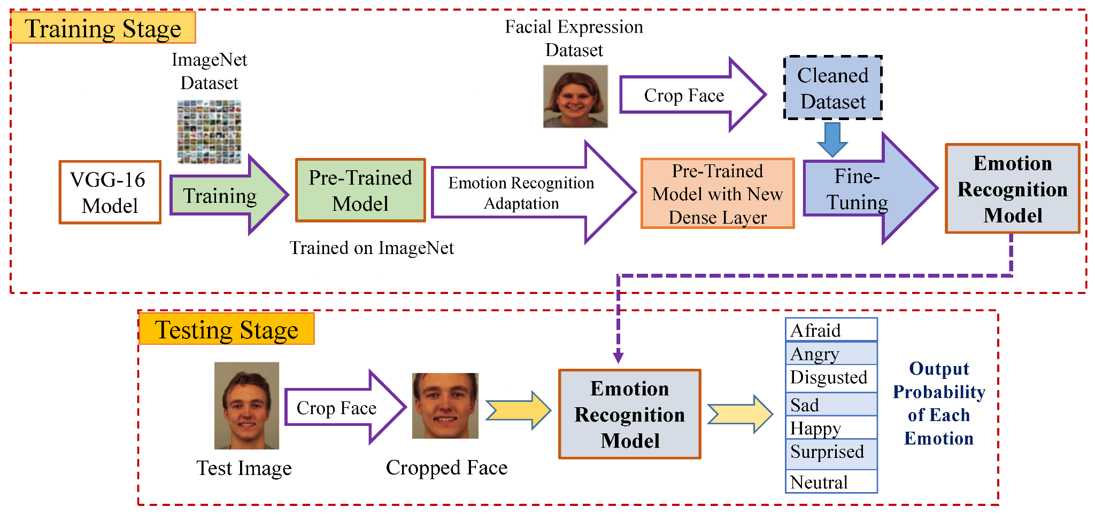
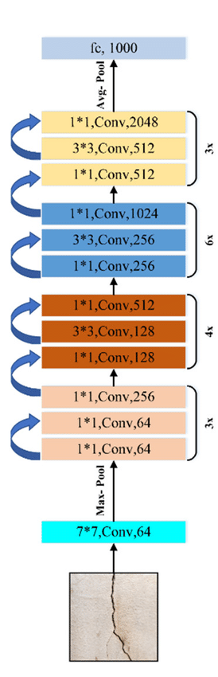
Model Creation
Transfer Learning (ResNet50)
ResNet 50
Notes:
We used the concept of transfer learning and selected resent50 model for the build. Transfer learning is a machine learning method where a model developed for a task is reused as the starting point for a model on a second task. For object recognition with a CNN, we freeze the early convolutional layers of the network and only train the last few layers which make a prediction. ResNet50 is a variant of the ResNet model which has 48 Convolution layers along with 1 MaxPool and 1 Average Pool layer. Also contains shortcut connections that simply perform identity mappings to reduce error that occurs in deep networks

Slide 11
Modeling Steps
Flatten layer
FCL - 512 units
FCL - 256
Layers
Parameters
Evaluation
Pre trained 50 conv layers
Flatten layer
FCL - 512 units
FCL - 256 units
FCL - 7 units
Activation Function - ReLu, Softmax
Epoch - 50
Optimizer - Adam
Batch size -32
Callbacks- EarlyStopping, ReduceLROnPlateau
Loss and accuracy plots
Heatmap of confusion matrix
Also we use some common techniques for each layer
● Batch normalization
● Dropout
Notes:
Out of 50 we first froze 45 layers and trained on last 5 layers and some additional fc layers
Multiclass classification
32 was the optimal parameter which didt crash the system and we were able to use the vectorication to increase the speed of training
Batch normalization is a technique where the output of each layer is normalized before entering the next layer
Dropout is a technique where randomly selected neurons are ignored during training which prevents all the neurons from converging to the same goal, thus decorrelating the weights.

Slide 12
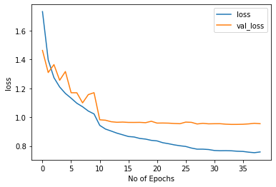
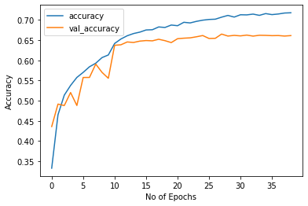
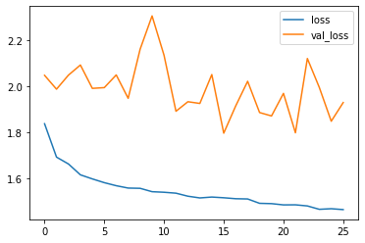
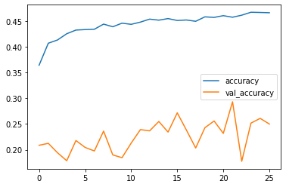
Model Evaluation
Categorical Crossentropy
Accuracy
Notes:
Accuracy 46,25
Loss 1.5,2

Slide 13
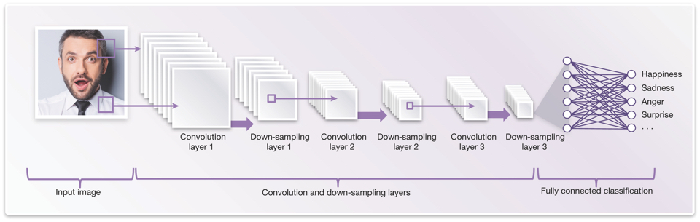
2) CNN
Notes:
Convolutional Neural Networks a special type of neural network that roughly imitates human vision.it is a class of deep neural networks, most commonly applied to analyze visual imagery.
ConvNet is used to reduce the images into a form that is easier to process, without losing features that are critical for getting a good prediction

Slide 14
Modeling Steps
Layers
Parameters
Evaluation
Layer 1- 3*3,Conv,64
Layer 2- 3*3,Conv,128
Layer 3- 3*3,Conv,254
Layer 4- 3*3,Conv,512
Flatten layer
FC - 512 units
FC - 256 units
FC - 7 units
Activation Function - ReLu, Softmax
Epoch - 50
Optimizer - Adam
Batch size -32
Callbacks- EarlyStopping, ReduceLROnPlateau
Loss and accuracy plots
Heatmap of confusion matrix
Also we use some common techniques for each layer
● Batch normalization
● Dropout
Notes:
Multiclass classification

Slide 15
Model Evaluation
Categorical Crossentropy
Accuracy
Notes:
Accuracy 71,66
Loss 0.8,1

Slide 16
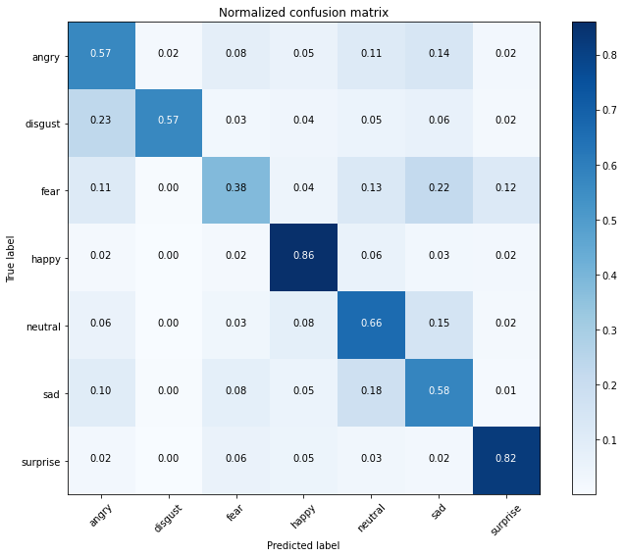
Confusion matrix (Heatmap)
Notes:
It is doing a great job in identifying happy and surprised facial expressions but is getting confused between angry and disgust.it is also performing poorly on recognizing feared emotion as it is getting confused with sad expression

Slide 17
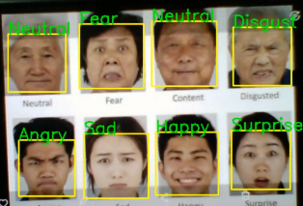
Real Time Face Emotion Detection
Notes:
On multiple faces at once

Slide 18
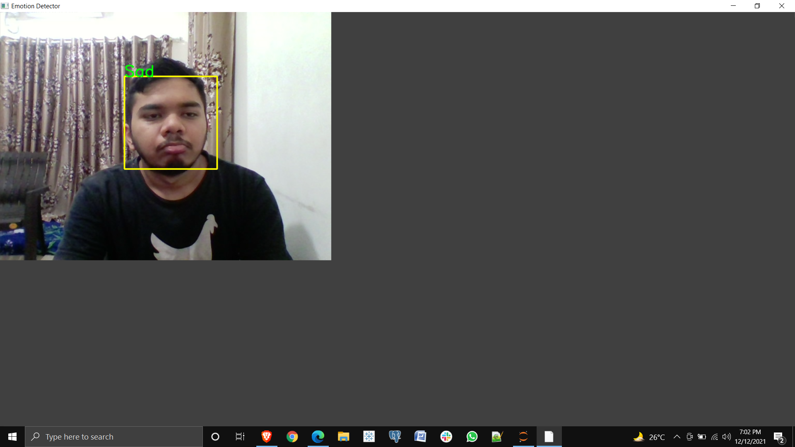
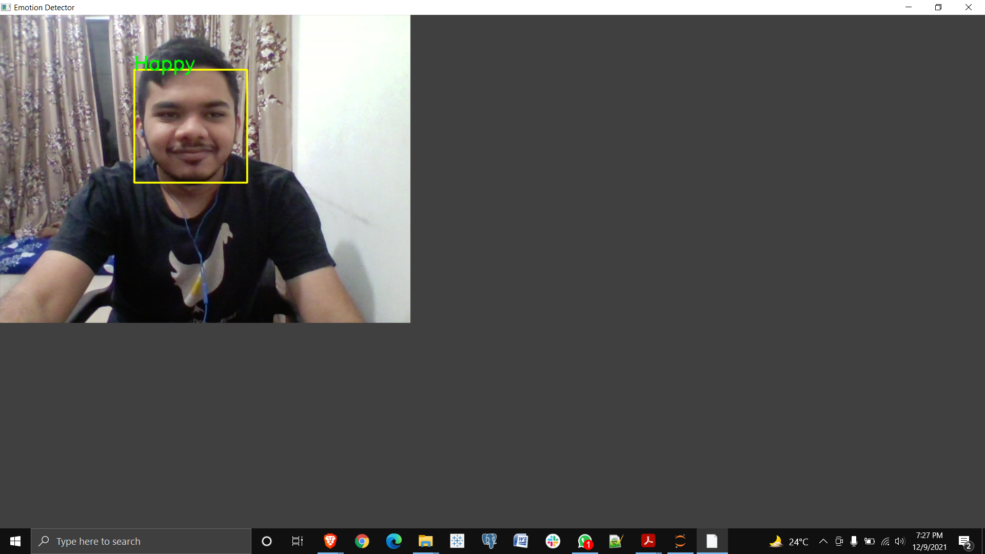
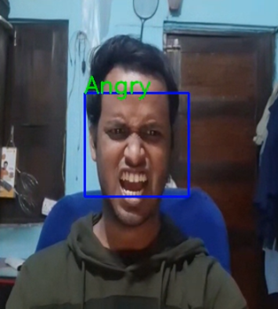
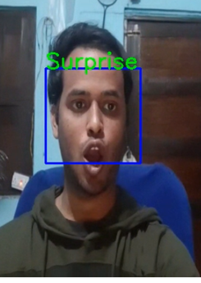
Real Time Face Emotion Detection
Notes:
On a single face

Slide 19

Deployment
Creating Web App Using Streamlit
Streamlit is an open-source python framework for building web apps for
Machine Learning and Data Science. We can instantly develop web
apps and deploy them easily using Streamlit. Streamlit allows you to
write an app the same way you write a python code. Streamlit makes it
seamless to work on the interactive loop of coding and viewing results
in the web app.
https://share.streamlit.io/aaryant31/face_emotion_recognition/main/app.py

Slide 20

Deployment
Deployment in cloud platform
Heroku is a container-based cloud Platform as a Service (PaaS) supporting several programming languages as Java, Node.js, Scala, Python, PHP, and Go.
https://face-recognition-emotion.herokuapp.com/

Slide 21
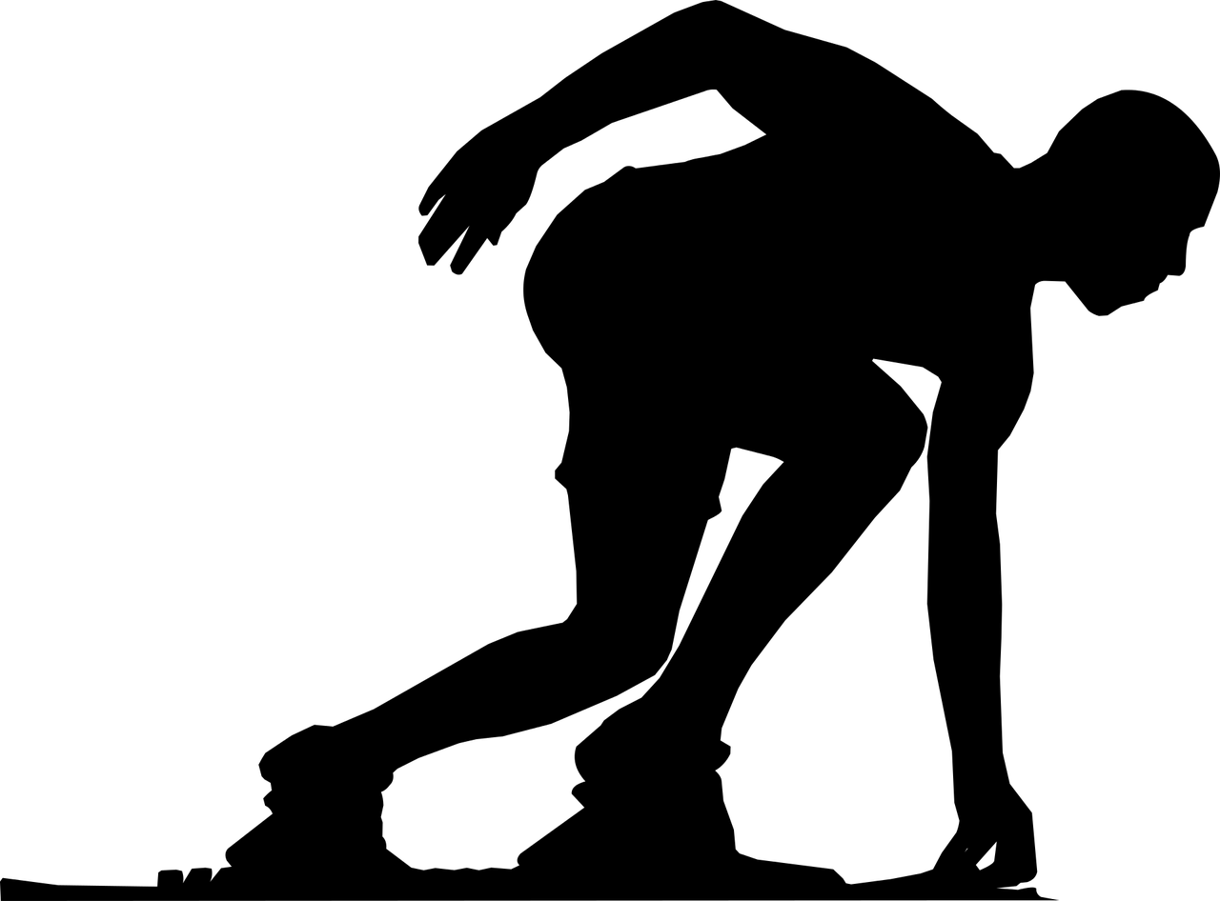
Challenges
Large image dataset to handle
Connecting Gpu to jupyter
Selecting No. of filters and neurons
Selecting batch size to avoid crashing of the system
Deployment

Slide 22

Conclusion
The CNN model gave us training accuracy of 71 % and validation accuracy of 66 %.
A front-end model was successfully created using Streamlit and run on a local webserver.
Successfully deployed Streamlit web app on Heroku and streamlit share that runs on a web server.

Slide 23
Thank You

